Slide 1
mapping wifi names
sam lavery

Slide 2
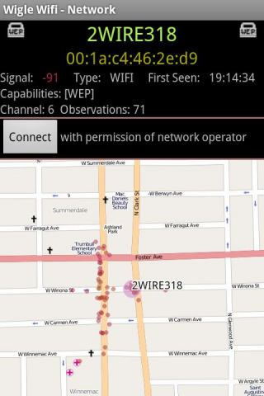
WiGLE wifi wardriving

Slide 3
the data

Slide 4
mapped using tilemill

Slide 5
mapped using tilemill

Slide 6
processing sketch
XLS reader by Florian Jenett
Unfolding library by Till Nagel
controlP5 by Andreas Schlegel

Slide 7
demo

