Slide 1
Sleep
Info Visualization
By Duncan Boehle

Slide 2
Background
I wanted to visualize sleep data
I had already been gathering some using my phone

Slide 3
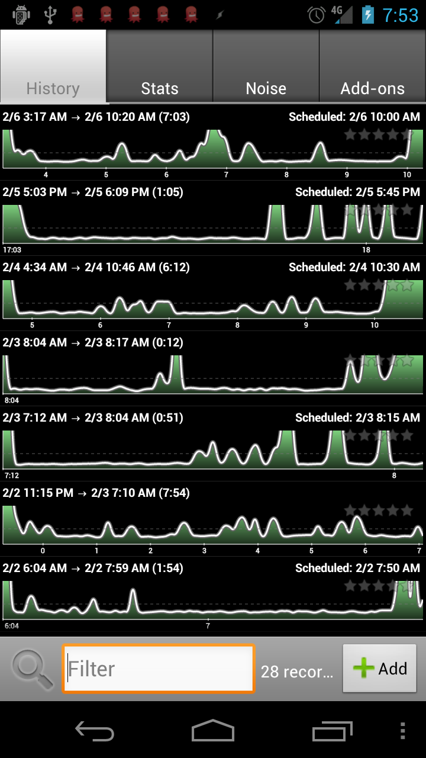
Background
This visualization already exists
But it’s boring

Slide 4
Background
I decided I wanted to not only creatively visualize this data, but also convey an emotion
I was really tired.

Slide 5
Background
Interactivity seemed powerful and interesting
Simplicity is more important

Slide 6
Demo
Without further ado…
http://www.youtube.com/watch?v=D_hMDVep_dU

Slide 7
How-To
Made in Unity3D
Used a human model from a free character pack, and sampled a song from Godspeed You! Black Emperor

Slide 8
How-To
The human ragdoll is mostly taken care of by Unity
The physics need to be carefully tuned to be stable, performant, and look nice

Slide 9
How-To
A slew of visual effects:
  SSAO (screen-space ambient occlusion)
  Deferred rendering with soft shadowed point lights
  Render targets for mirror
  Built-in VFX like white noise, vignette, and pixel swirling
  Decals for blood spatter
  Improper camera clearing for finale

Slide 10
Improvements
Data isn’t very clear
Emotional message also isn’t totally clear

