Slide 1
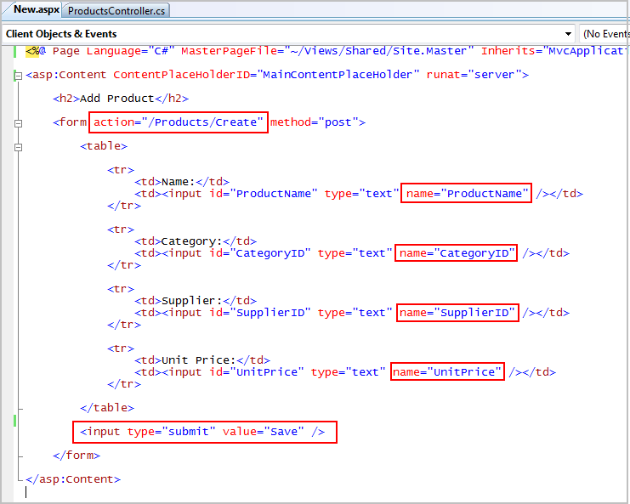
Subverting a form to reveal subconscious visualizations.
“….thoughtlessly submit….”
– Albert Einstein

Slide 2
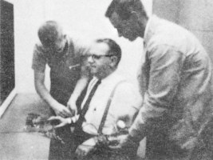
Misdirection and Deception.
Distracting to gain a less skewed data set.
For those interested in mining the subconscious.

Slide 3

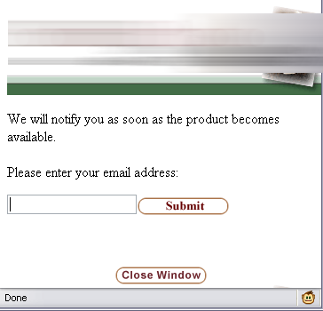
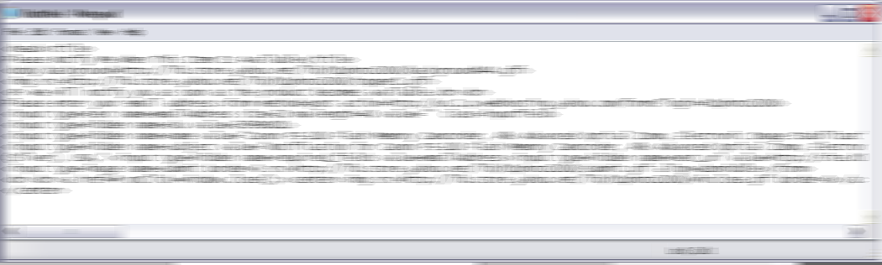

Slide 4
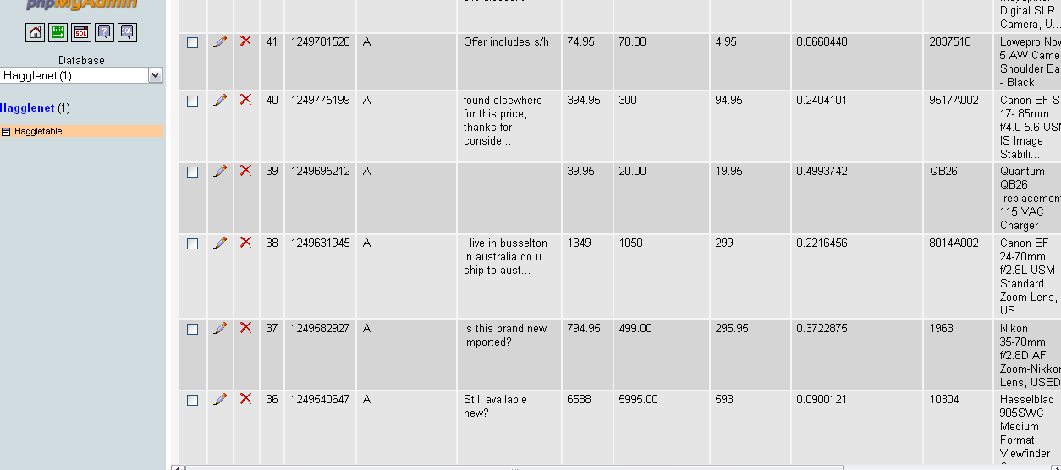
<form method=post action=http://us.1.p.webhosting.yahoo.com/forms?login=ACCOUNTNAME>
<input type=image name=submit border=0 src=http://lib.store.yahoo.net/lib/ACCOUNTNAME/submit.gif align=absmiddle>
Submit.gif was a 105x22 pixel gif that looked like this:
But probably smaller.

Slide 5
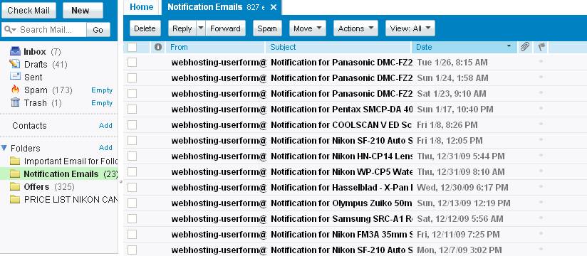
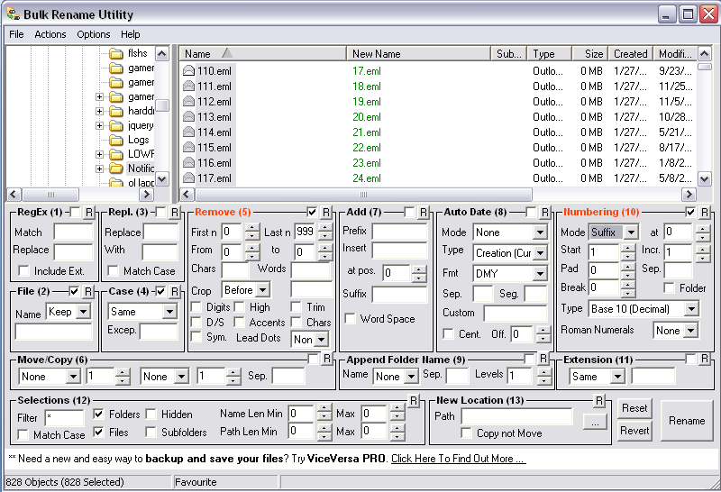
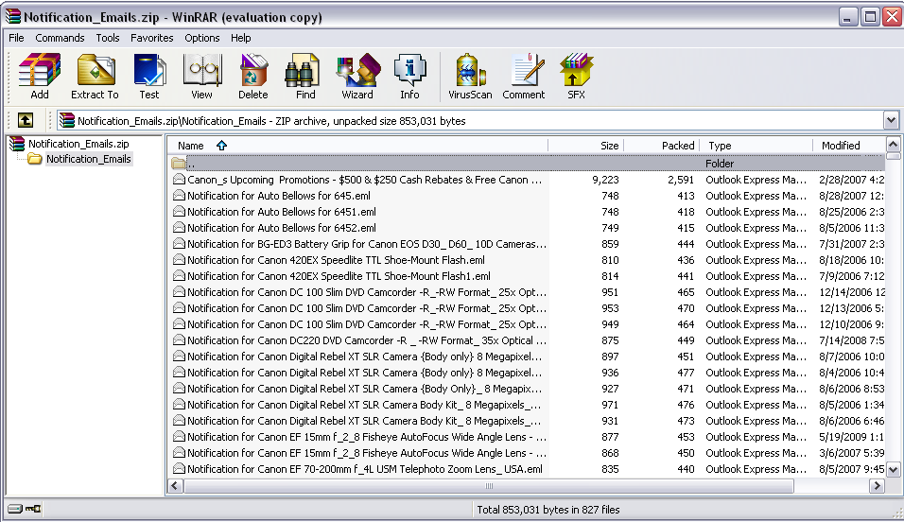

Slide 6
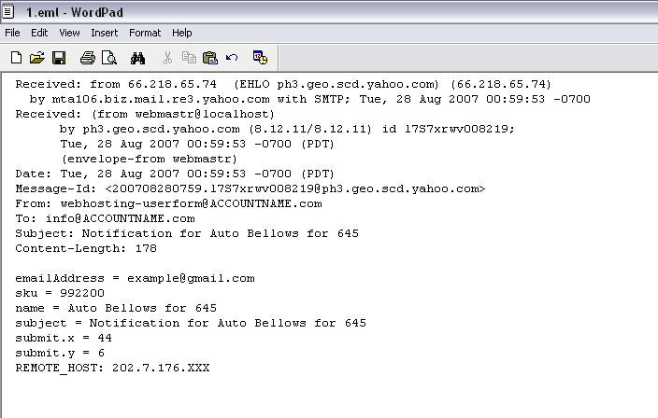
emailAddress = example@gmail.com sku = 992200 name = Auto Bellows for 645 subject = Notification for Auto Bellows for 645 submit.x = 44 submit.y = 6
REMOTE_HOST: 202.7.176.130

Slide 7
size(1050, 220);
PImage b;
b = loadImage("../submitlarge.gif");
background(b);
String[] lines;
for (int i = 1; i < 821; i++) {
lines = loadStrings("../"+i+".eml");
for (int j=0; j < lines.length; j++) {
if (match(lines[j],"submit.x")!=null){
String xstring = lines[j].substring(lines[j].length()-2);
String ystring = lines[j+1].substring(lines[j+1].length()-2);
int x = Integer.parseInt(trim(xstring));
int y = Integer.parseInt(trim(ystring));
print("x: "+x);
println("y: "+y);
fill(0, 30);
stroke(0, 50);
if (x!=0)rect(10*x,10*y,10,10);
saveFrame("saved/picture.tga");
}
}
}

Slide 8
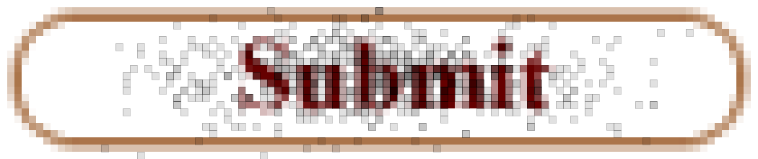

Slide 9
for (int xcount=0; xcount<106; xcount++)
for (int ycount=0; ycount<23; ycount++)
{
float amt = constrain(((twodarray[xcount][ycount])*.20),0,1);
if (amt == 0)
opac = 40;
else
if (amt == .20)
opac = 80;
else
opac = 140;
fill (lerpColor(to, from, amt),opac);
stroke(0,50);
if (xcount!=0)rect(10*xcount,10*ycount,10,10);
}
saveFrame("saved/picture.tga");
size(1050, 220);
PImage b;
b = loadImage("../submitlargebw.gif");
background(b);
int[][] twodarray;
twodarray = new int[106][23];
color from = color(255, 0, 0);
color to = color(0, 102, 153);
int opac;
String[] lines;
for (int i = 1; i < 821; i++) {
lines = loadStrings("../"+i+".eml");
for (int j=0; j < lines.length; j++) {
if (match(lines[j],"submit.x")!=null){
String xstring = lines[j].substring(lines[j].length()-2);
String ystring = lines[j+1].substring(lines[j+1].length()-2);
int x = Integer.parseInt(trim(xstring));
int y = Integer.parseInt(trim(ystring));
print("x: "+x);
println("y: "+y);
twodarray[x][y]++;
}
}
}

Slide 10
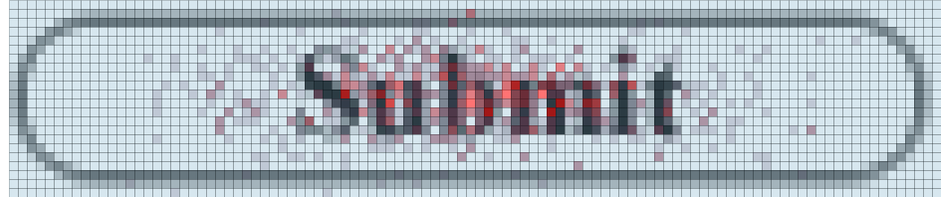
8

